Slide 1
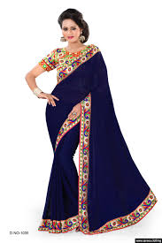
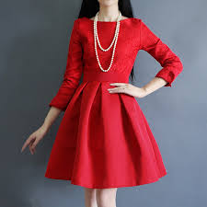
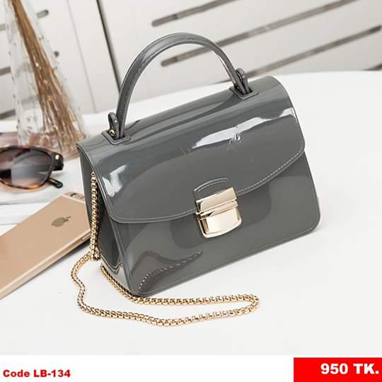
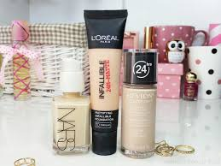
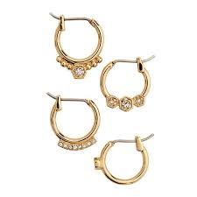
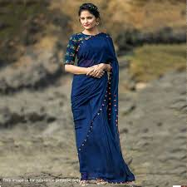
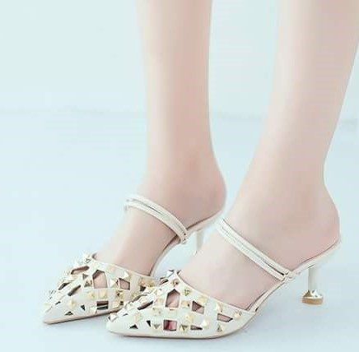
Welcome to
COSMATICS AND FASHION ZONE

Slide 2
Why we creat Cosmatics and Fashion Zone?
Establishing a career through this online shop Cosmatics and Fashion Zone.
Doing online business we can earn money to lead a better life.

Slide 3
HOME
REVIEWS
COSMATICS AND FASHION ZONE
PHOTOS
SERVICES
ABOUT
CONTACT US

Slide 4
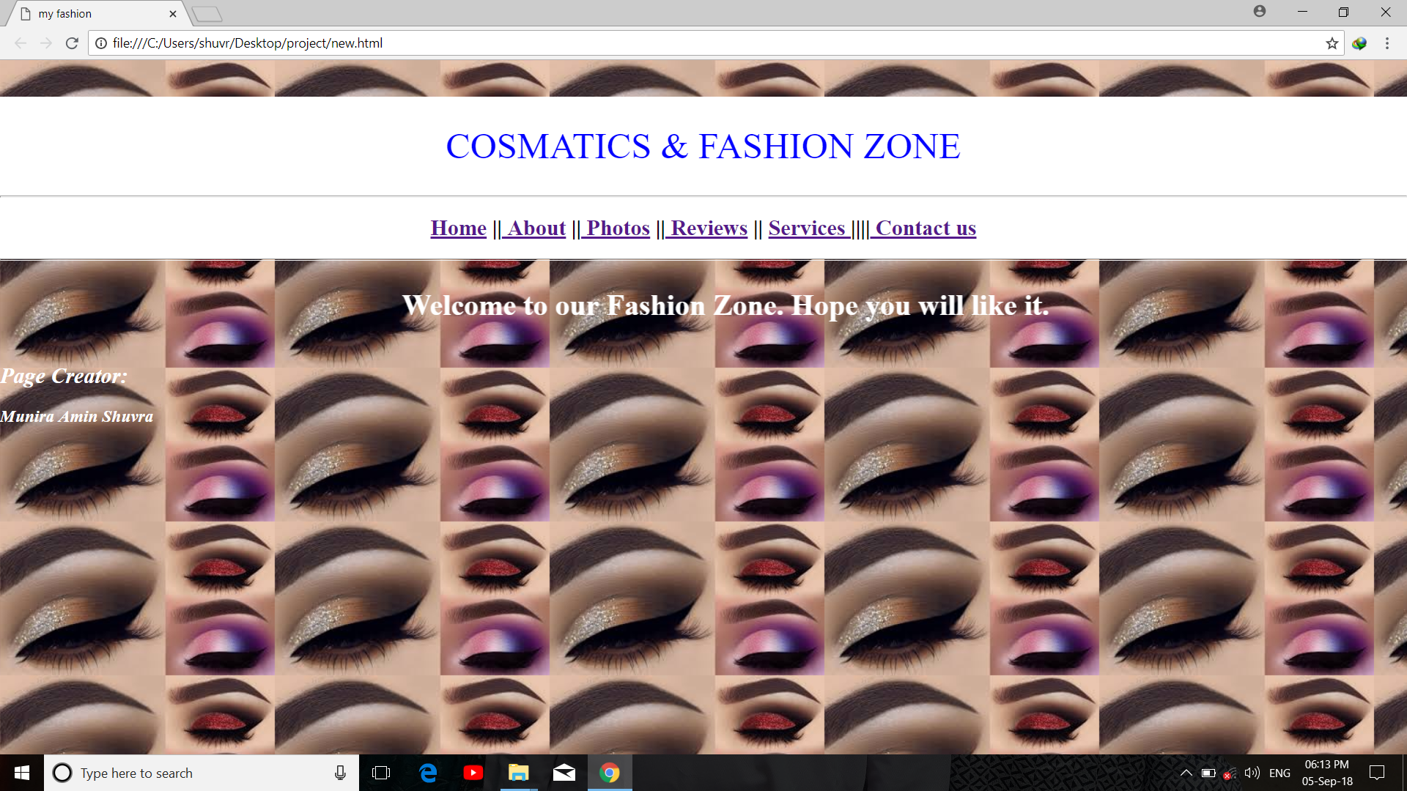
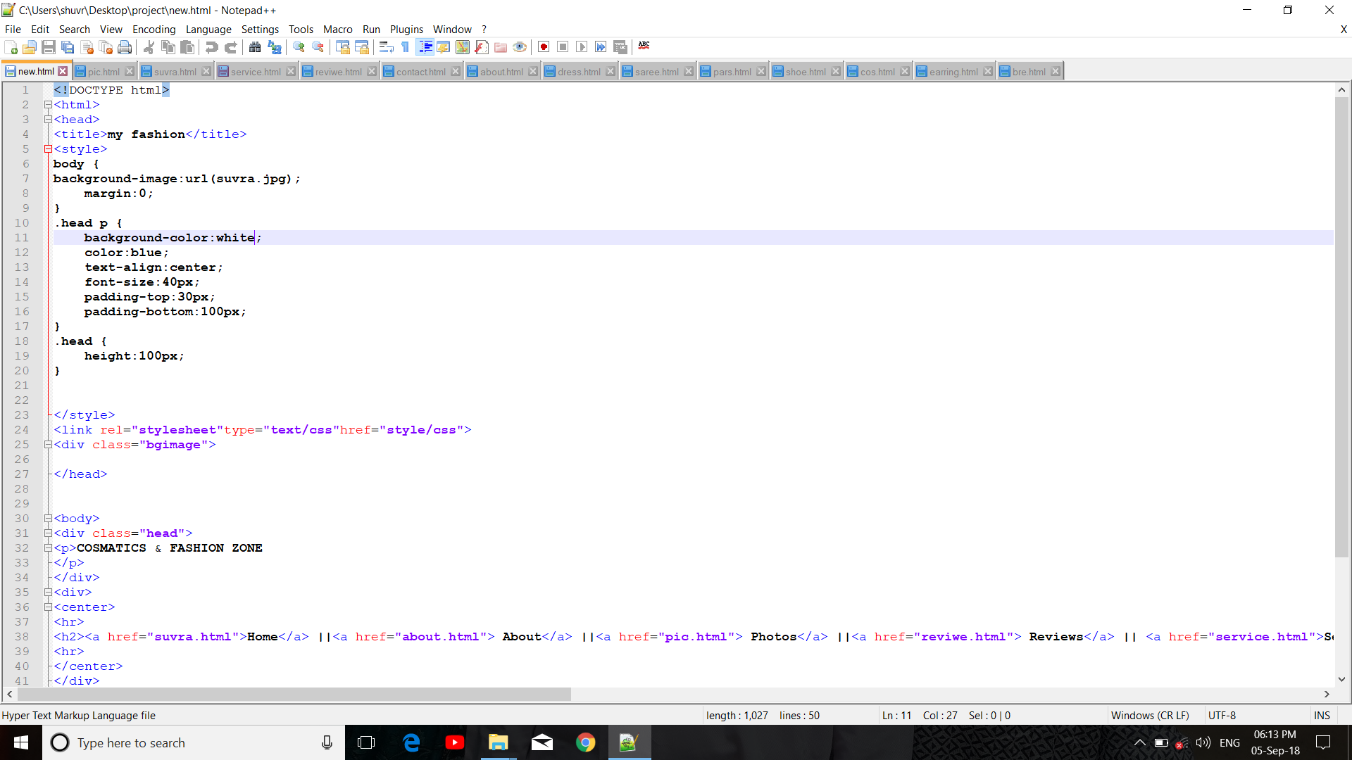
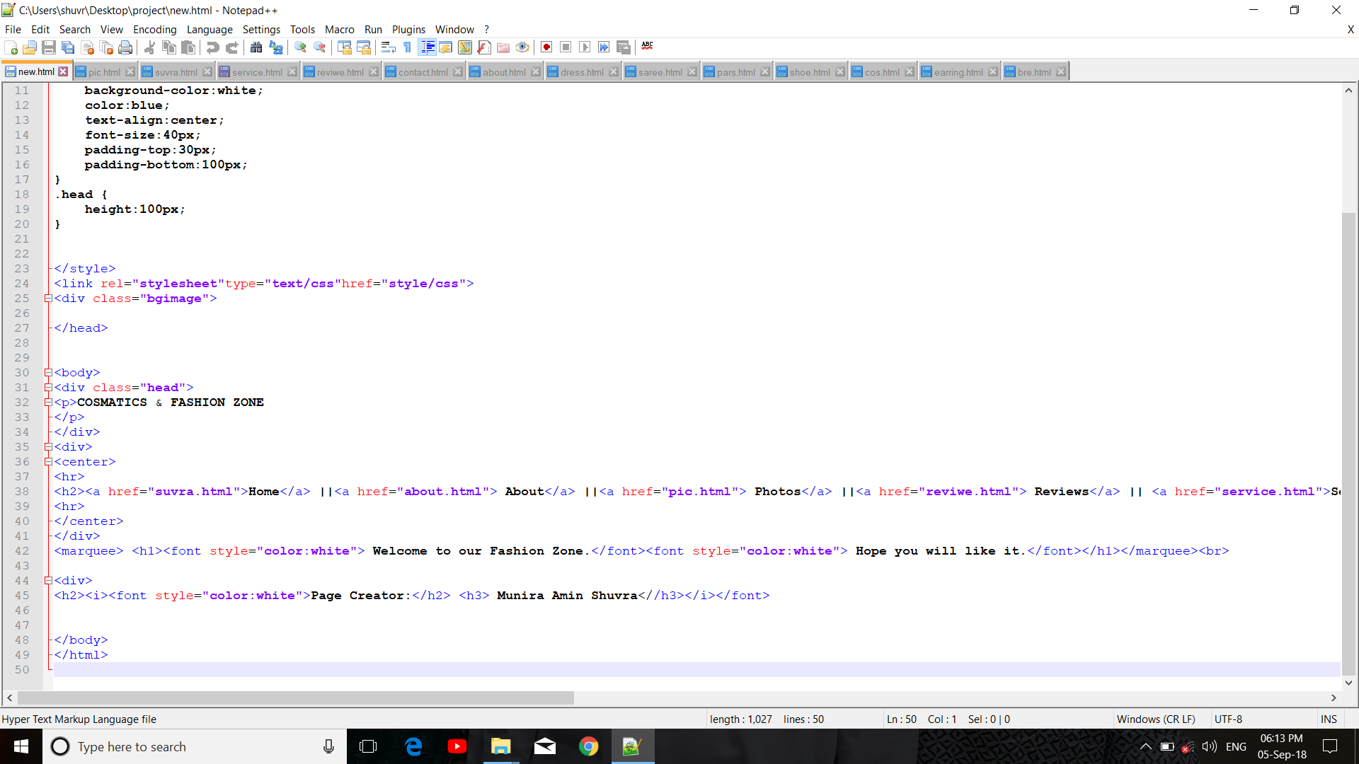
Its our main-page. Here we use CSS in header. And we also use Hyper Link to add one page to another page. We also use Marquee tag to Welcome our fashion zone. We use Background Image tag in CSS for background image. We use H3 tag for page creator.

Slide 5
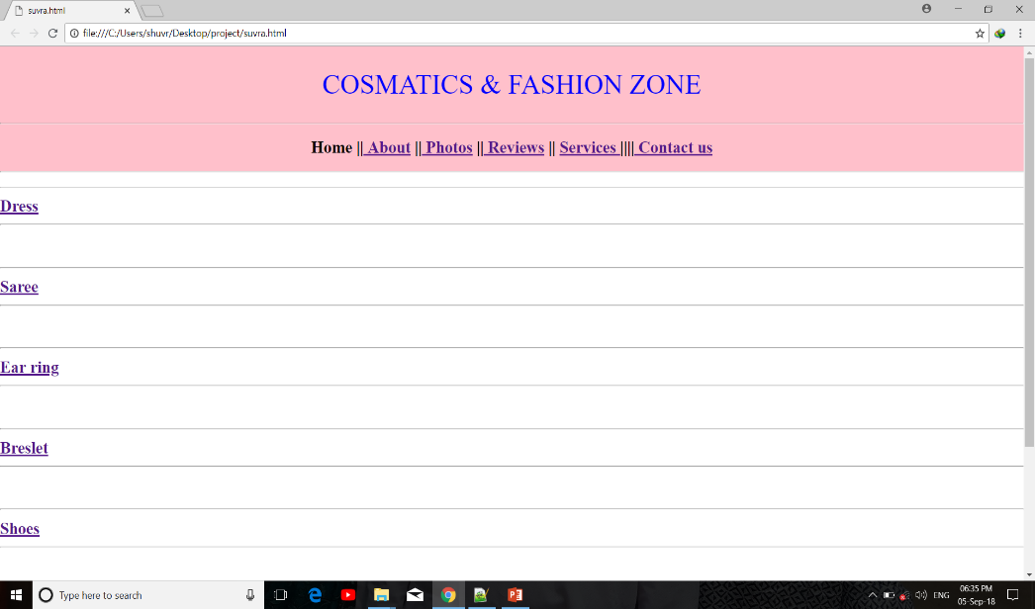
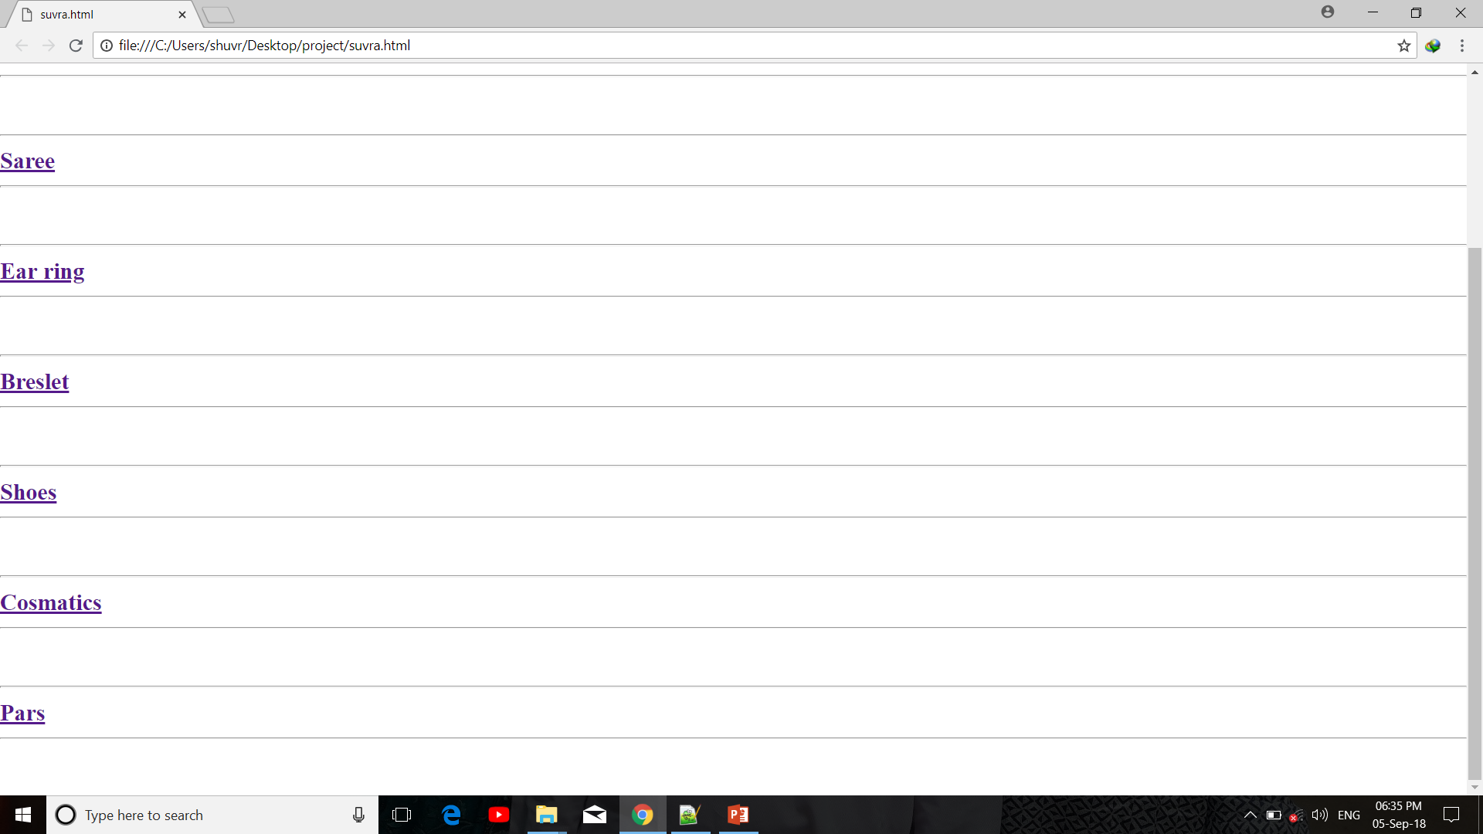
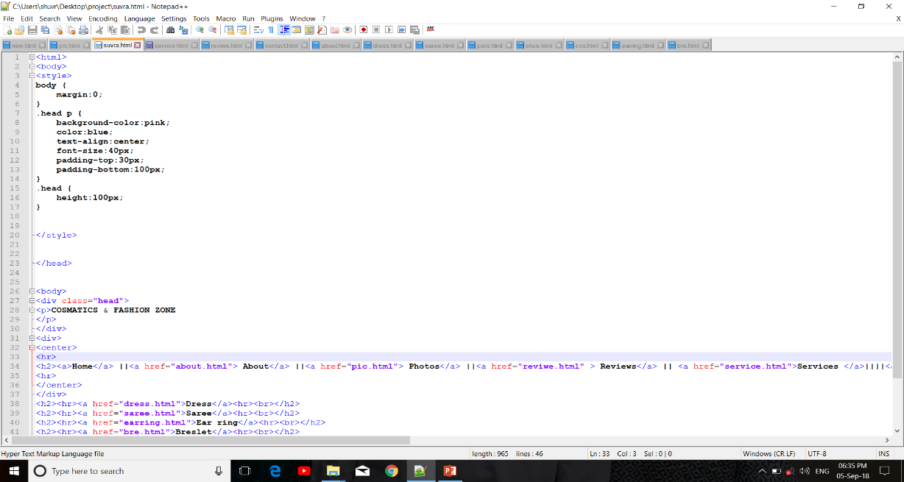
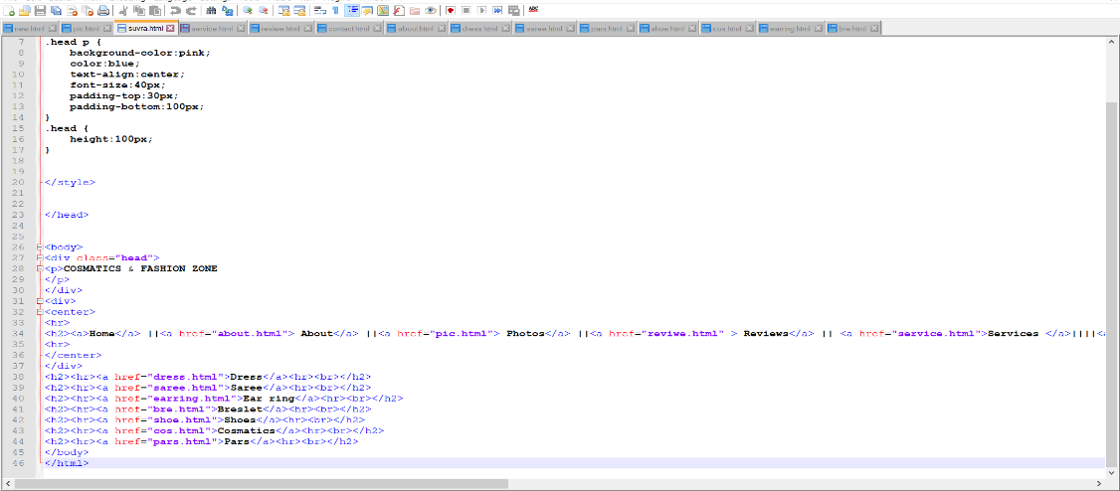
We use Hyper Link to see our product code. And we use Hr tag for add margin in the page. And also use CSS for menu bar and heading.

Slide 6
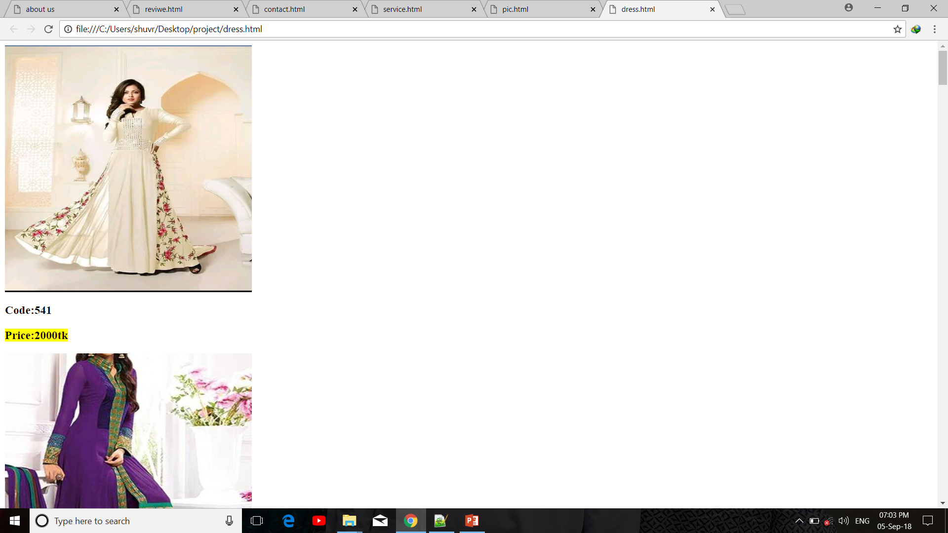
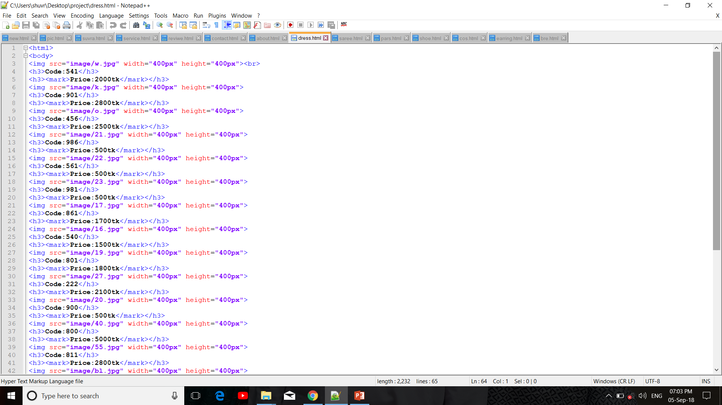
Here we use Image tag for add image in the page. Then we use H3 tag for add price and code.

Slide 7
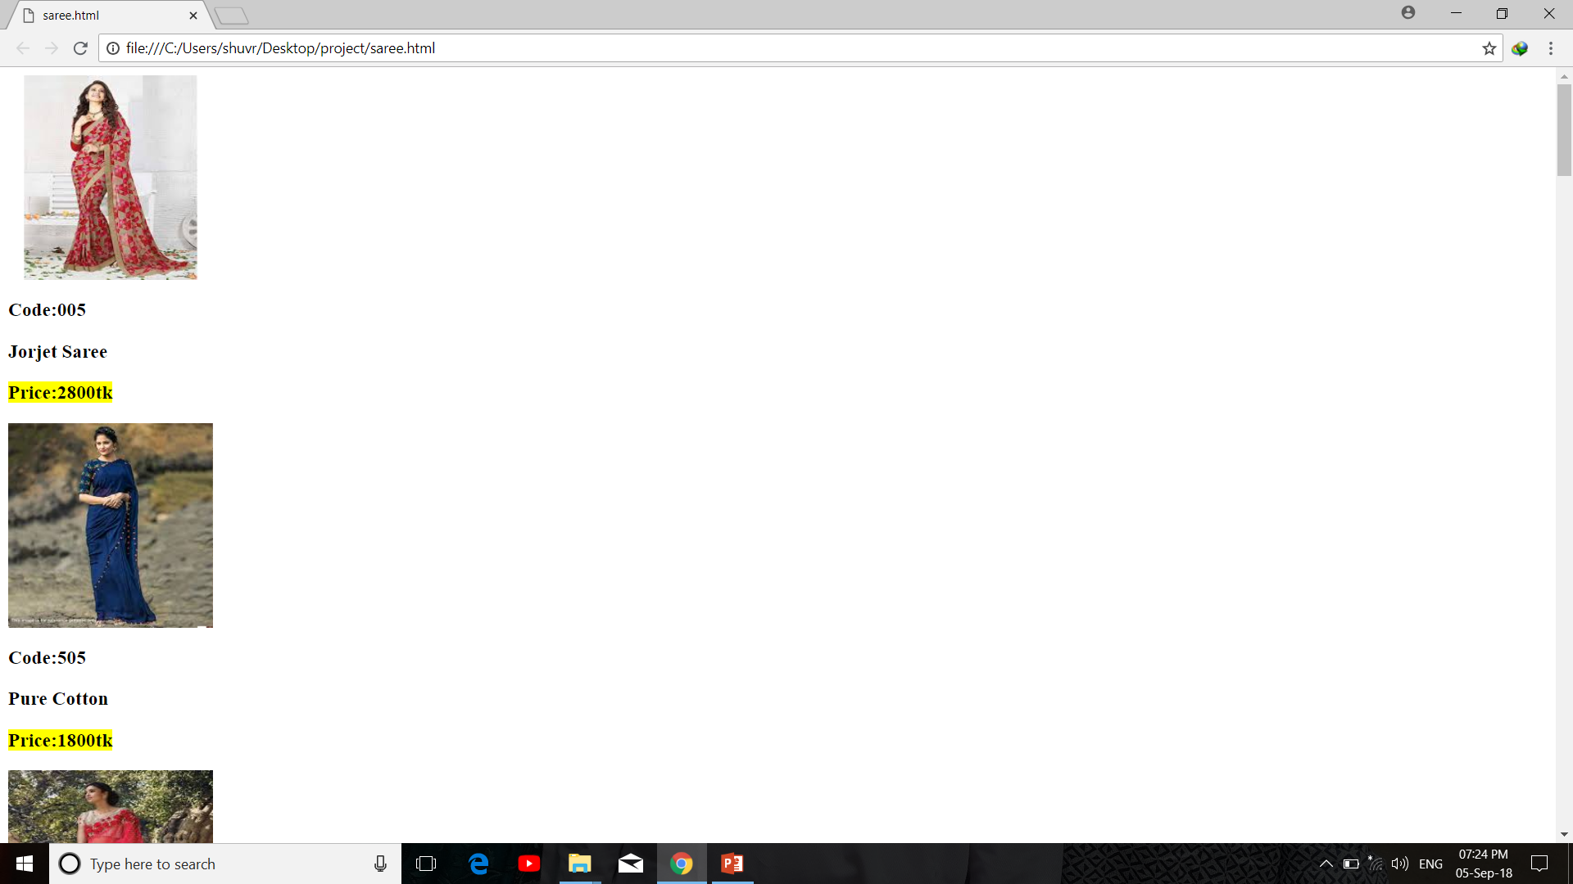
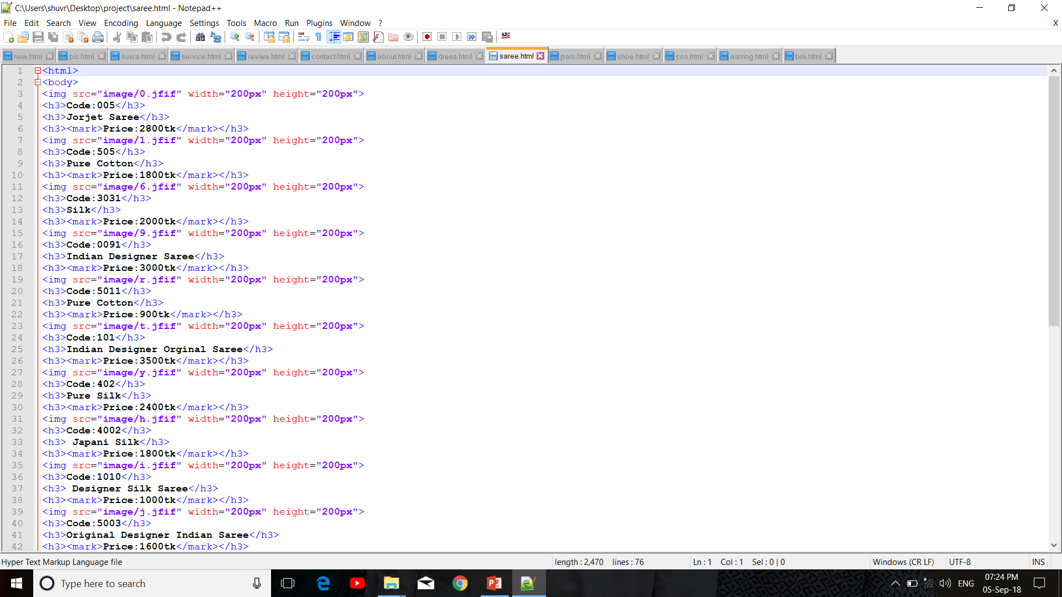
Here we use Image tag for add image in the page. Then we use H3 tag for add price and code.

Slide 8
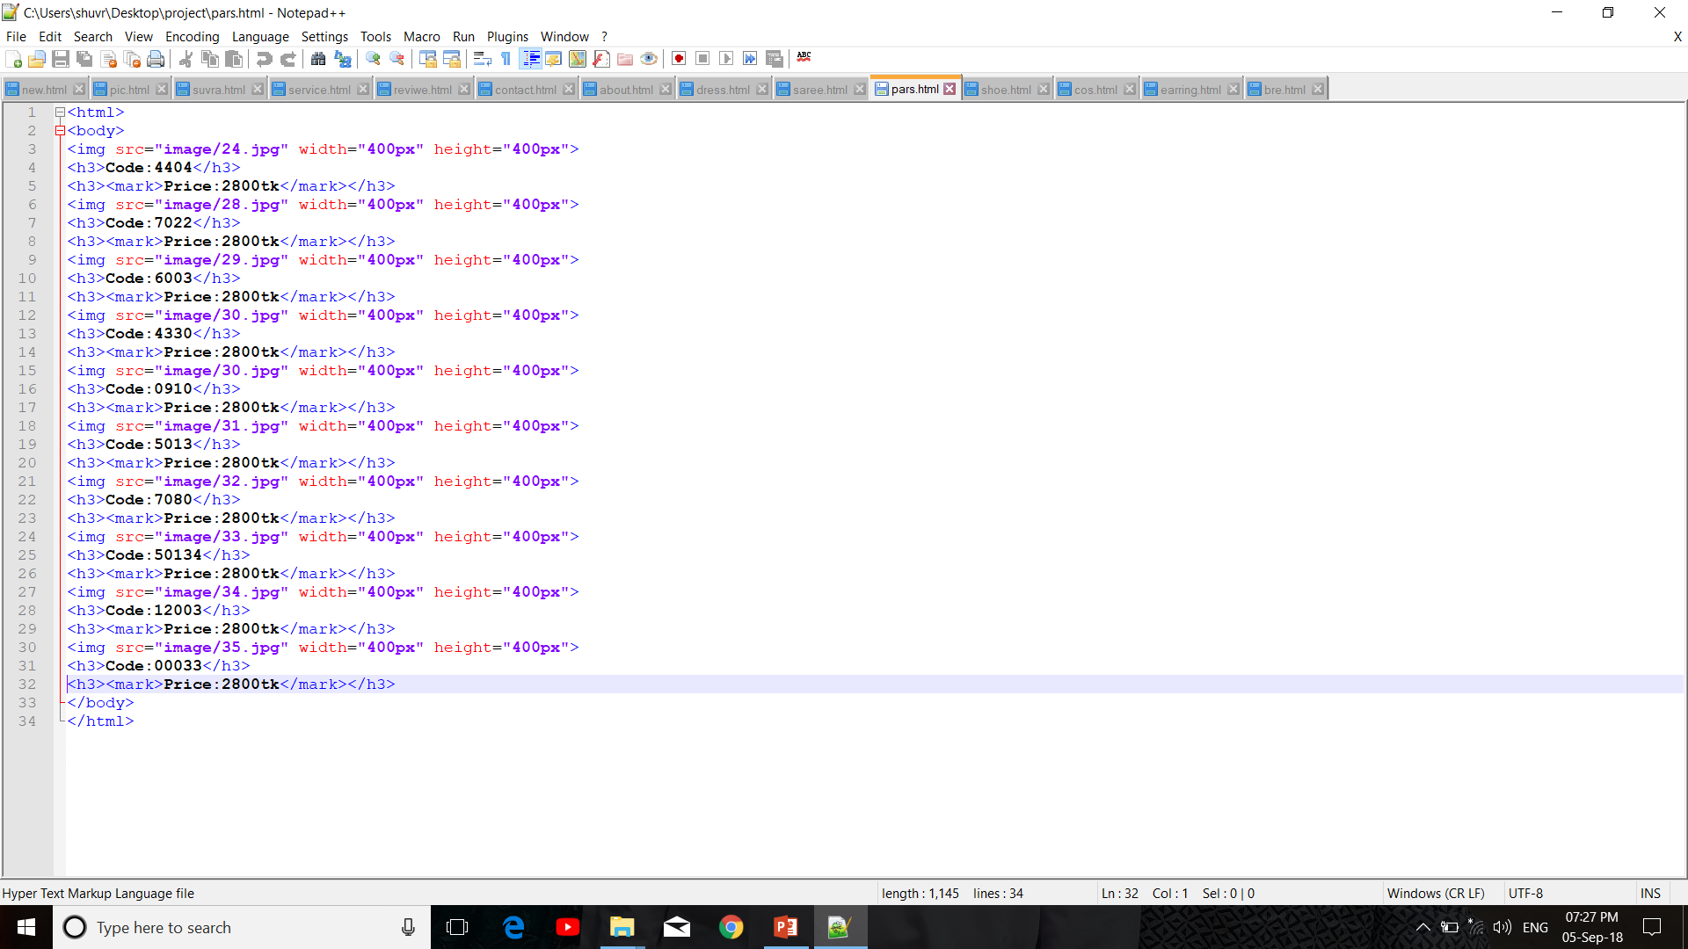
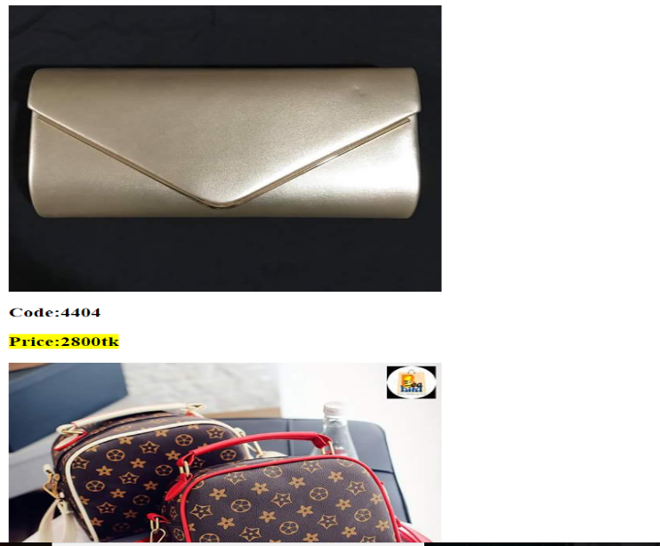
Here we use Image tag for add image in the page. Then we use H3 tag for add price and code.

Slide 9
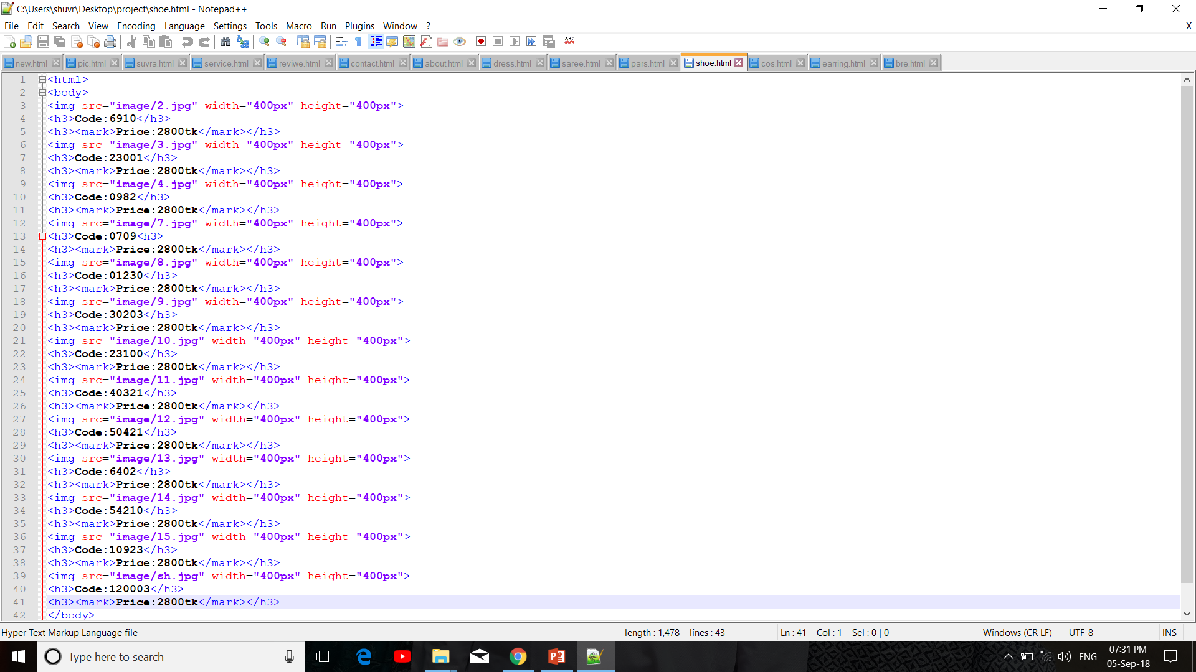
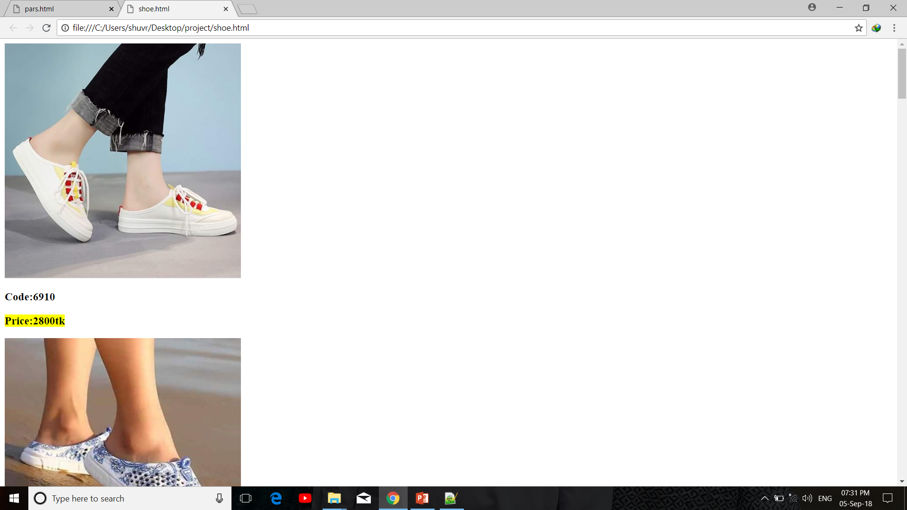
Here we use Image tag for add image in the page. Then we use H3 tag for add price and code.

Slide 10
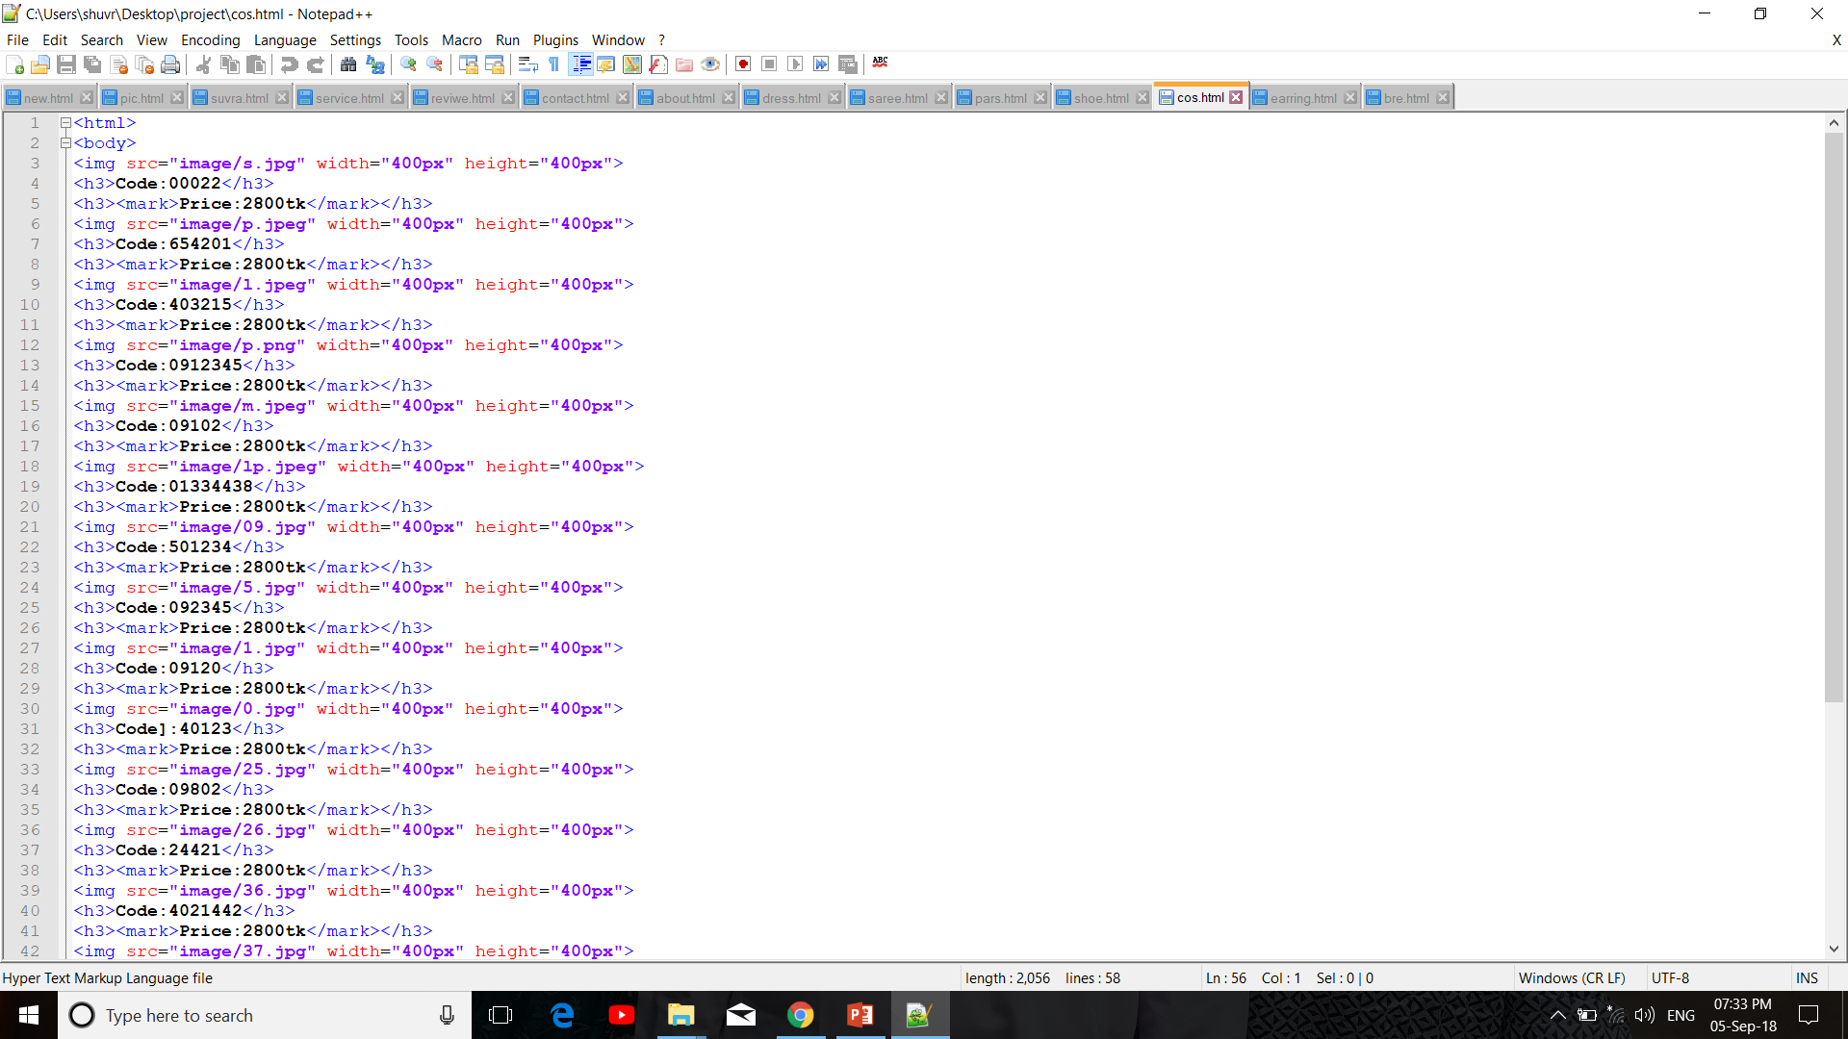
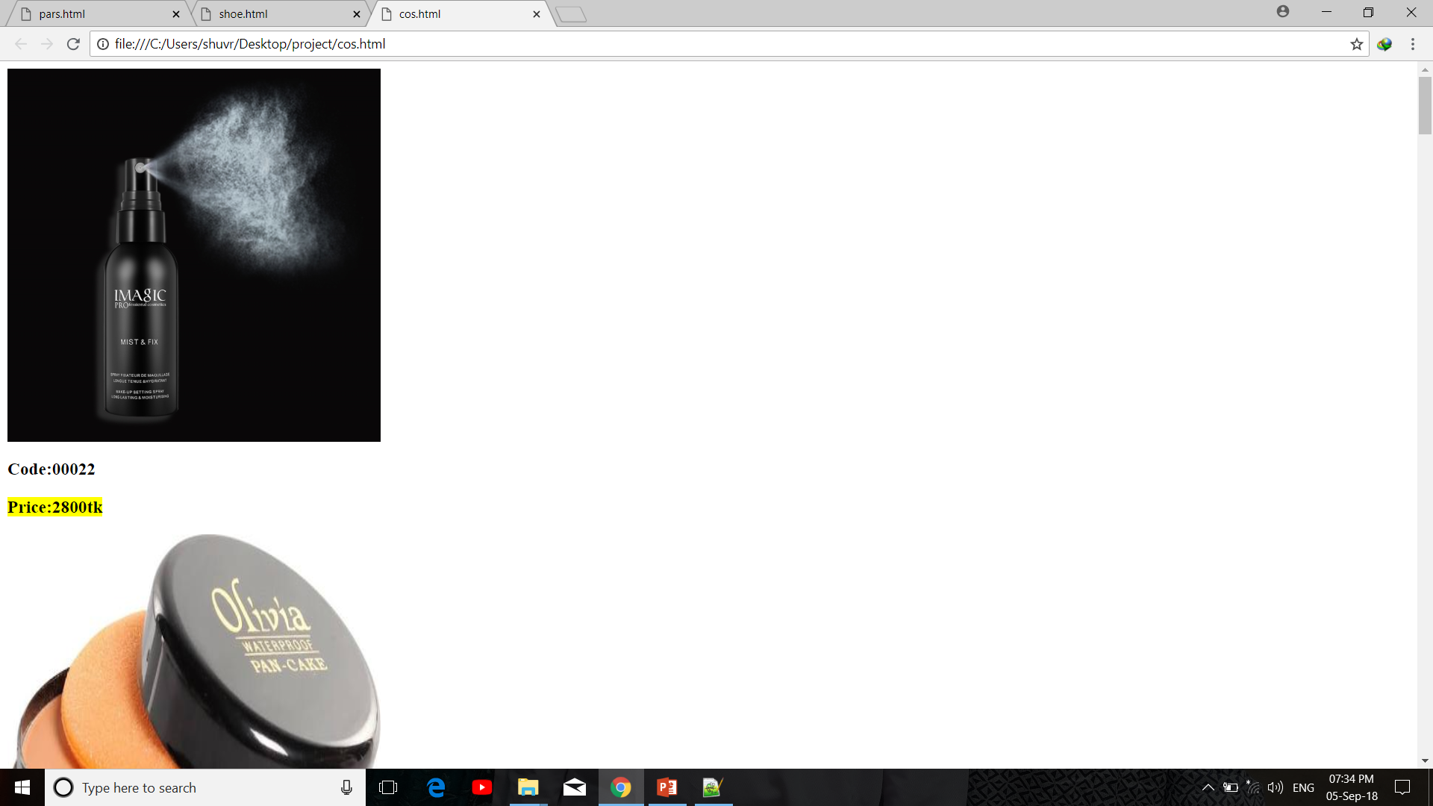
Here we use Image tag for add image in the page. Then we use H3 tag for add price and code.

Slide 11
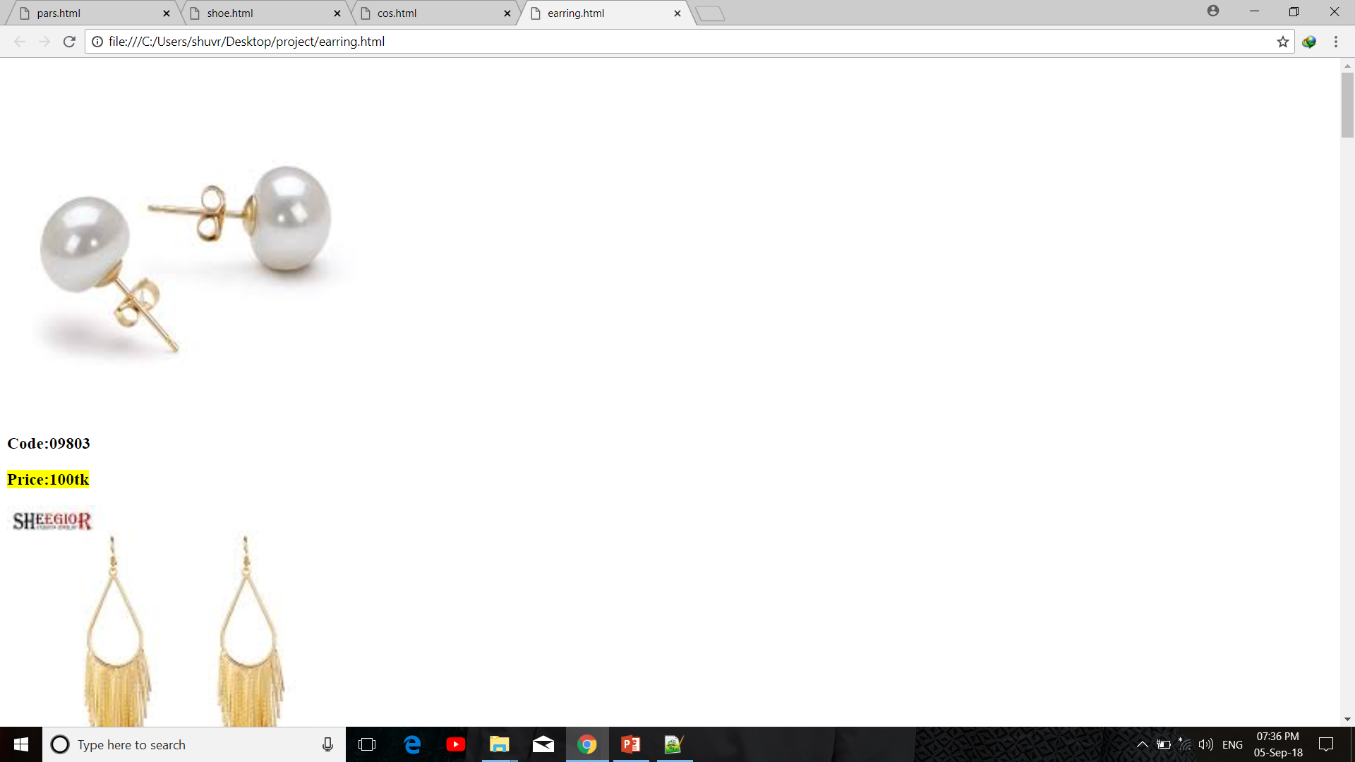
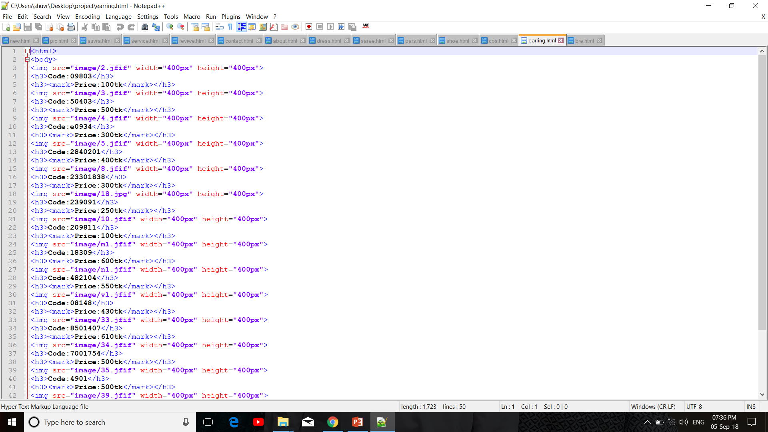
Here we use Image tag for add image in the page. Then we use H3 tag for add price and code.

Slide 12
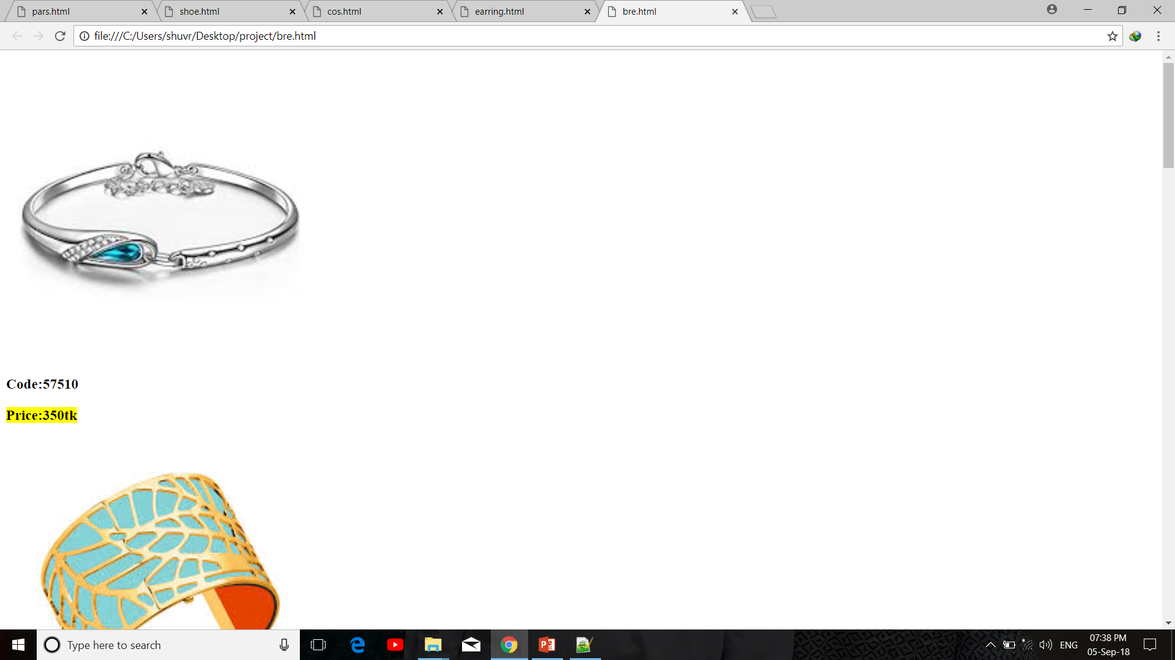
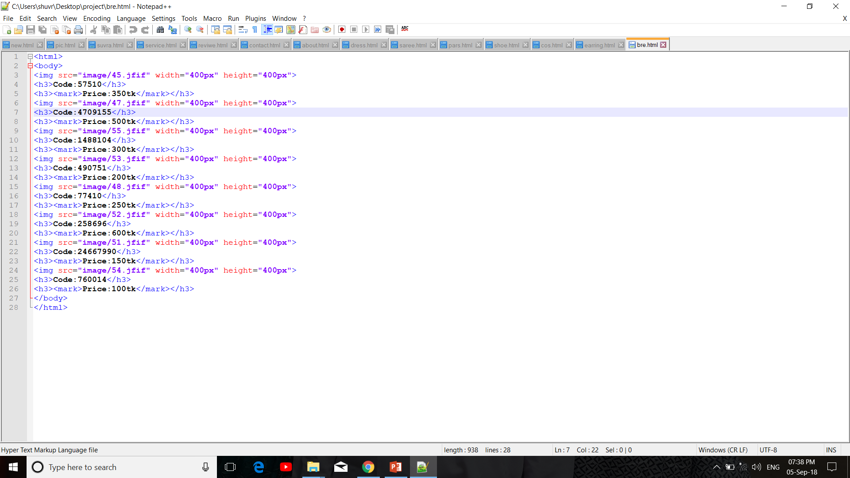
Here we use Image tag for add image in the page. Then we use H3 tag for add price and code.

Slide 13
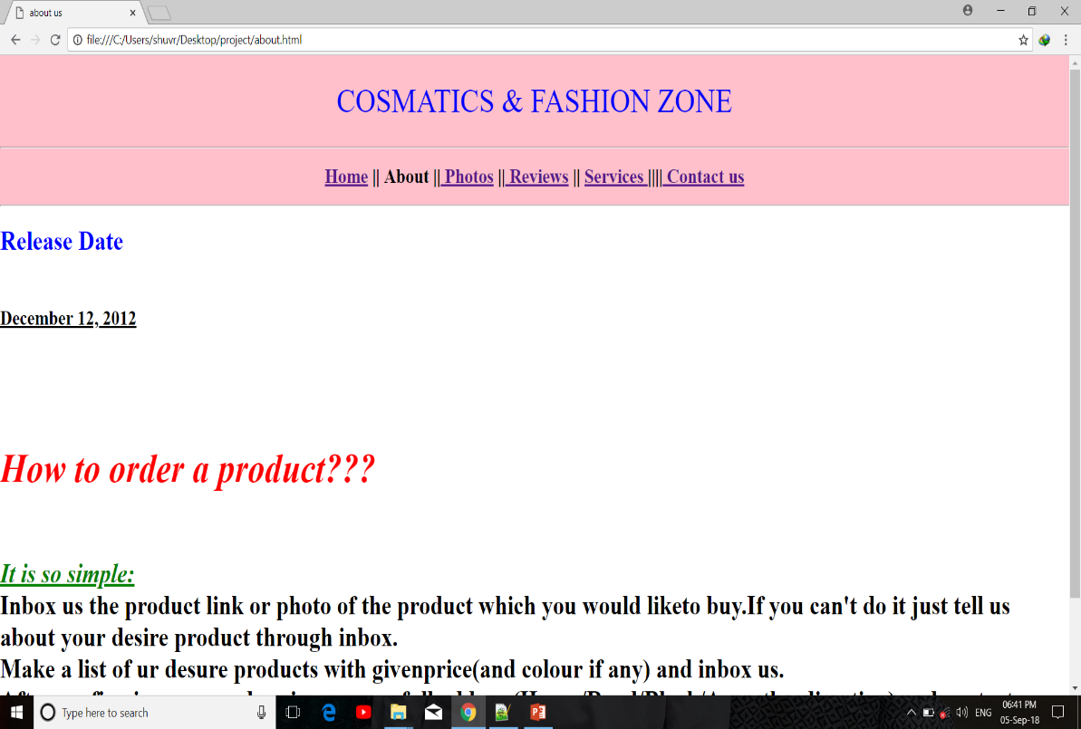
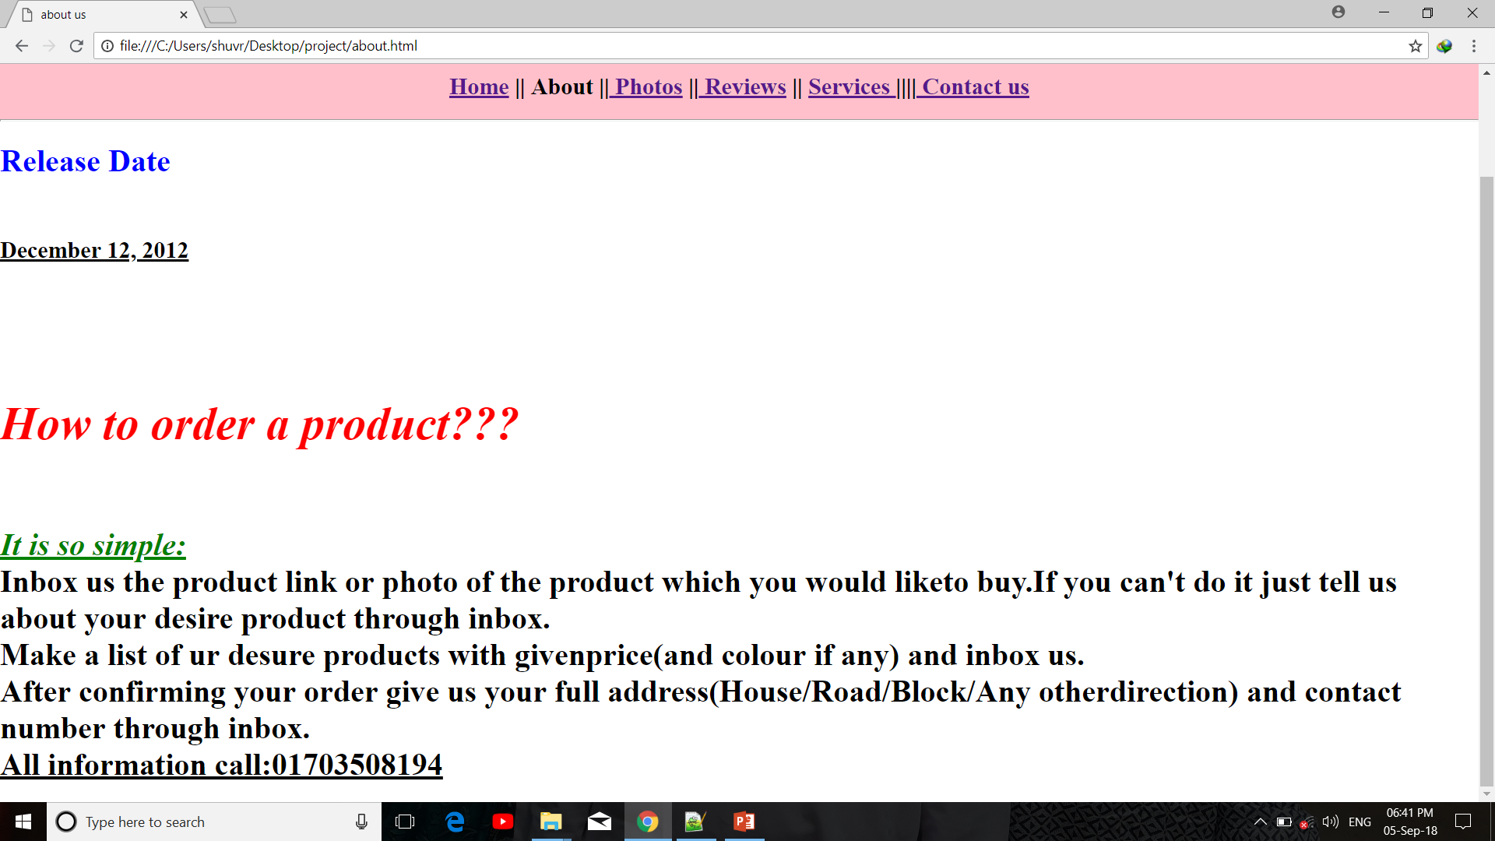
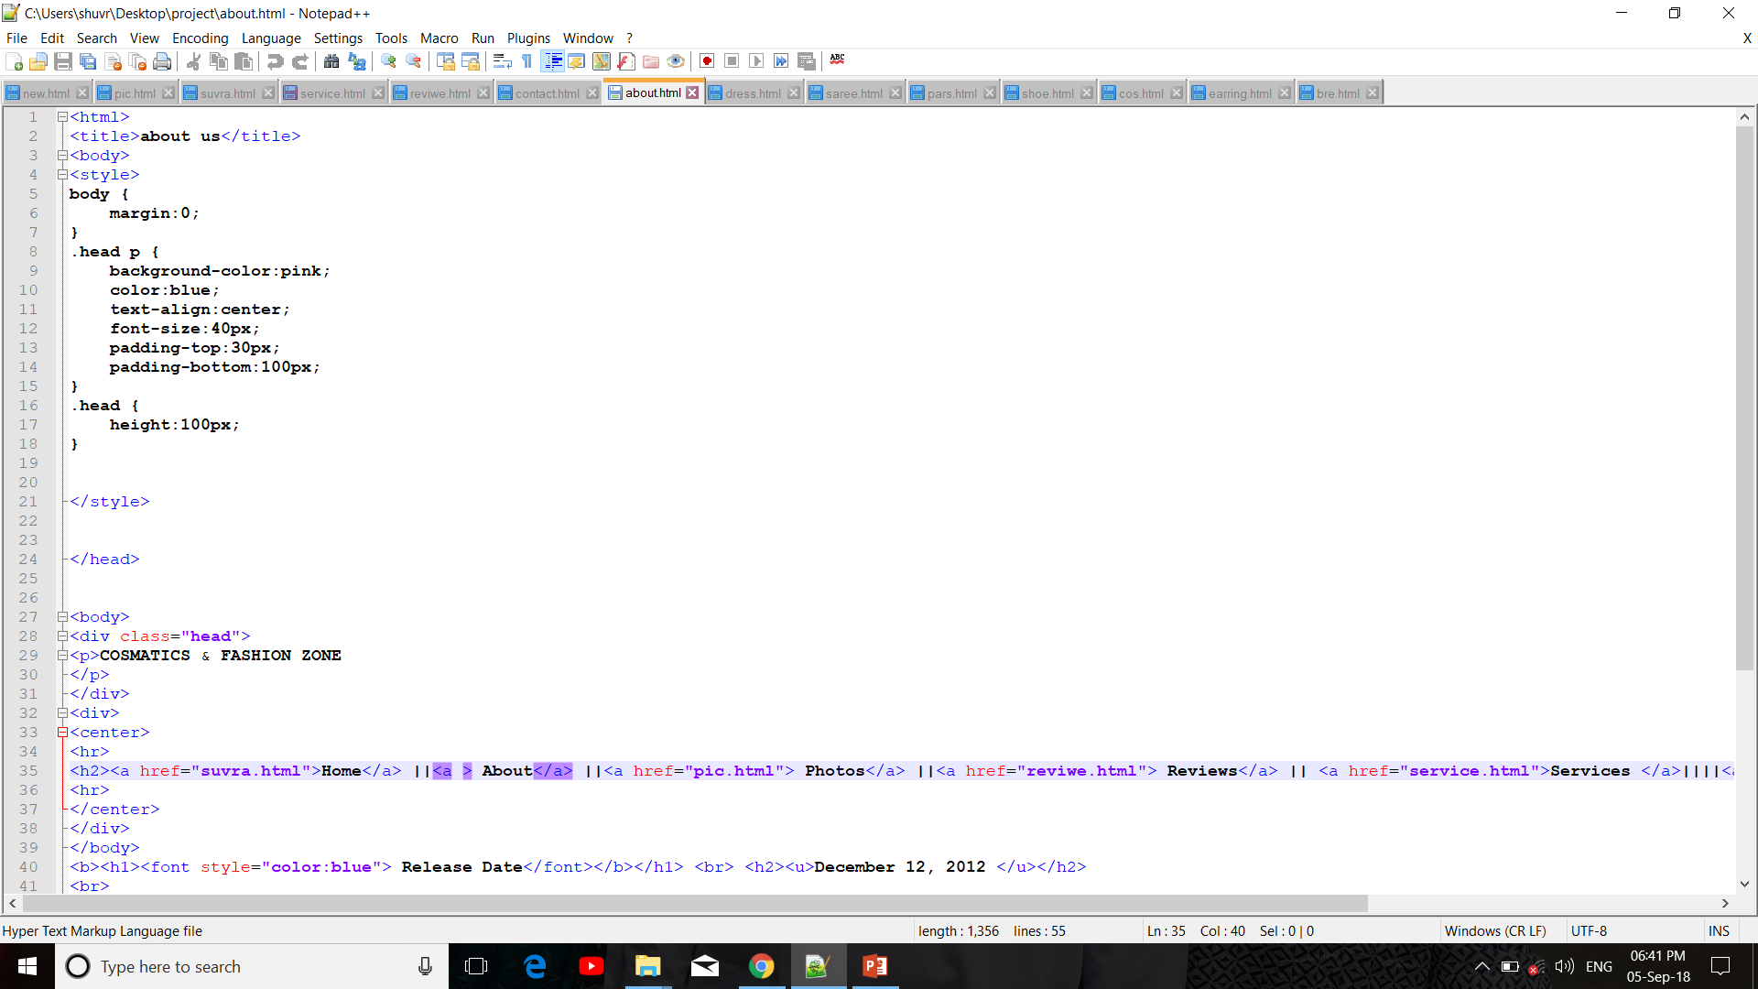
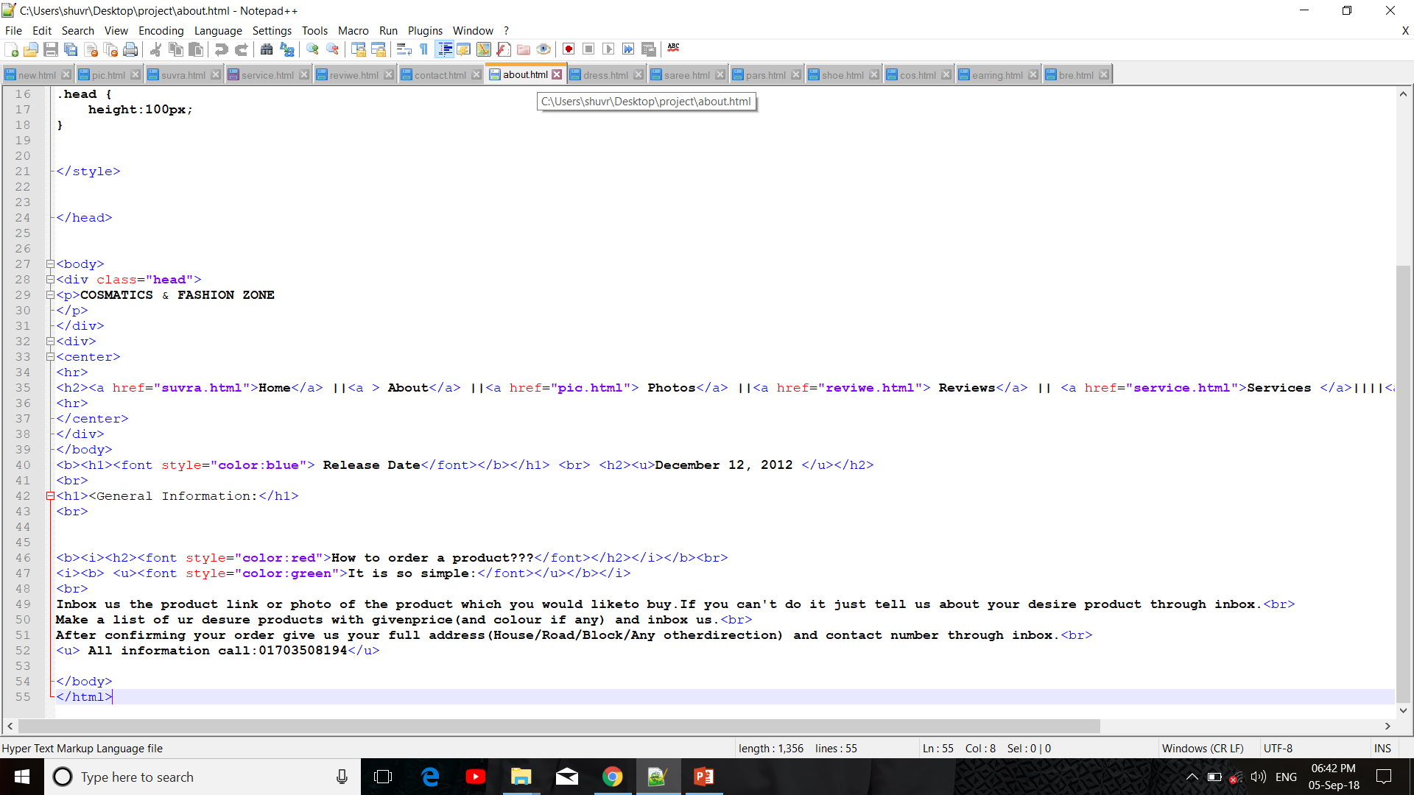
Here we use Font Color tag, Underline tag, Italic tag and h2,h3 tag to design our about page .

Slide 14
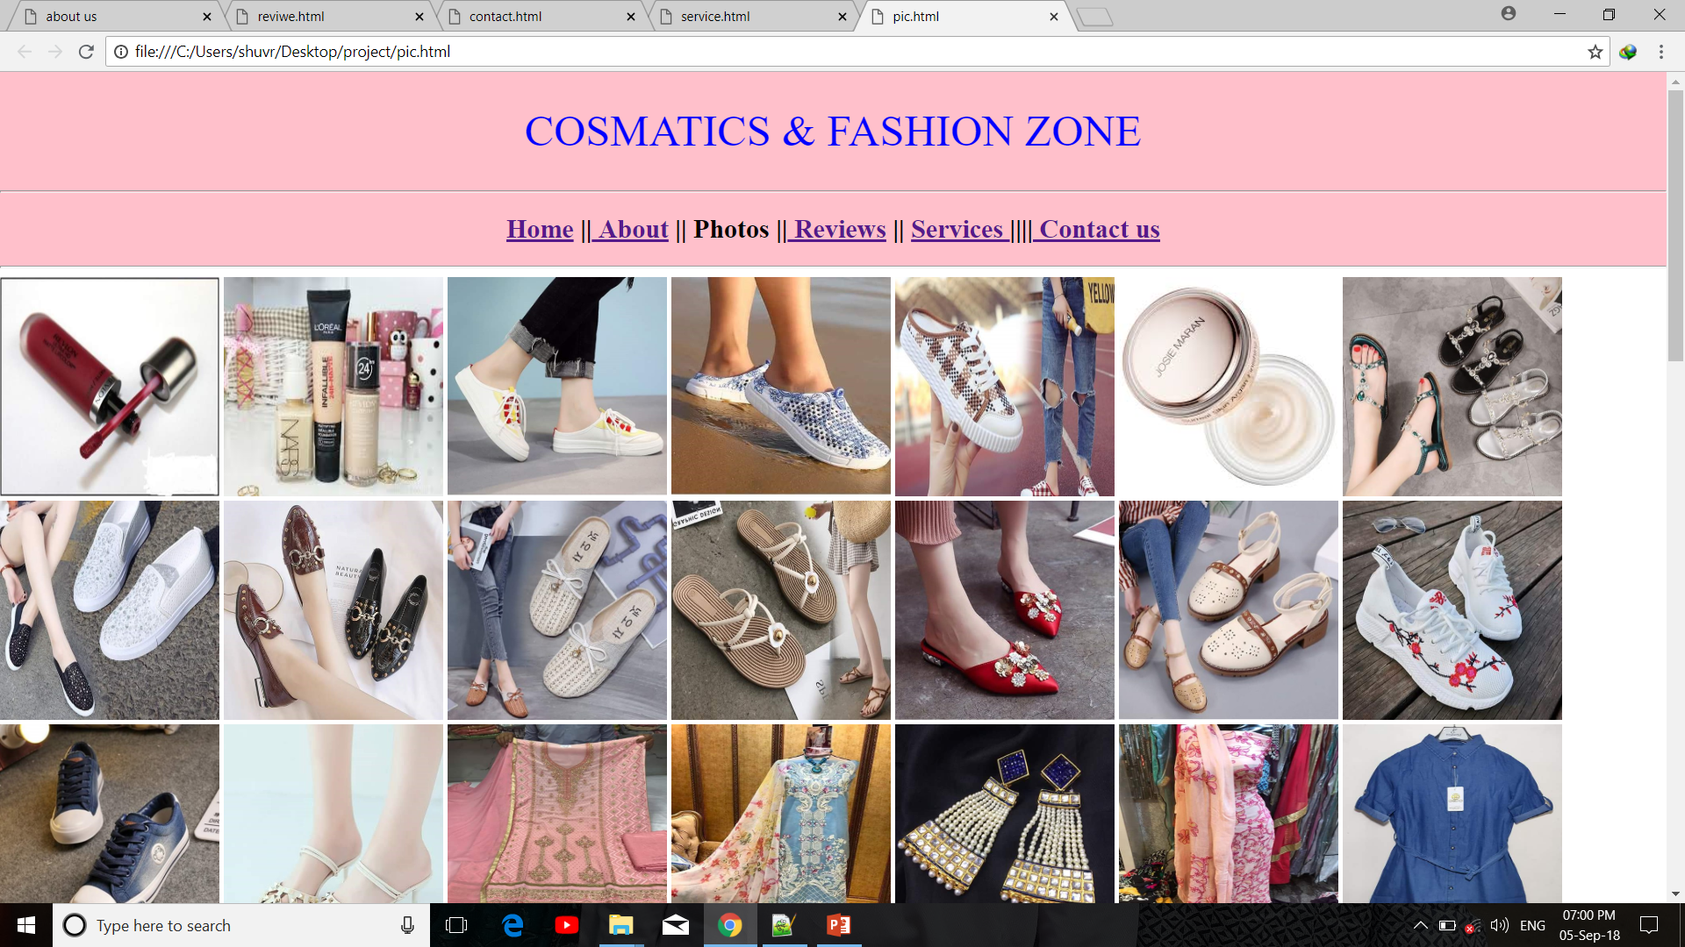
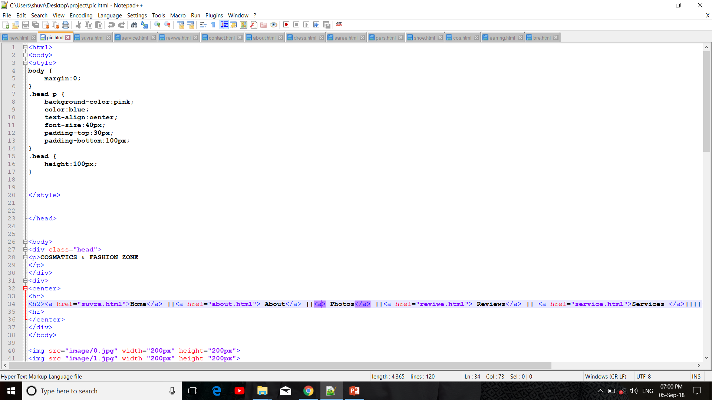
Here we use Image tag to creat our Photos page. And CSS for menu bar and heading.

Slide 15
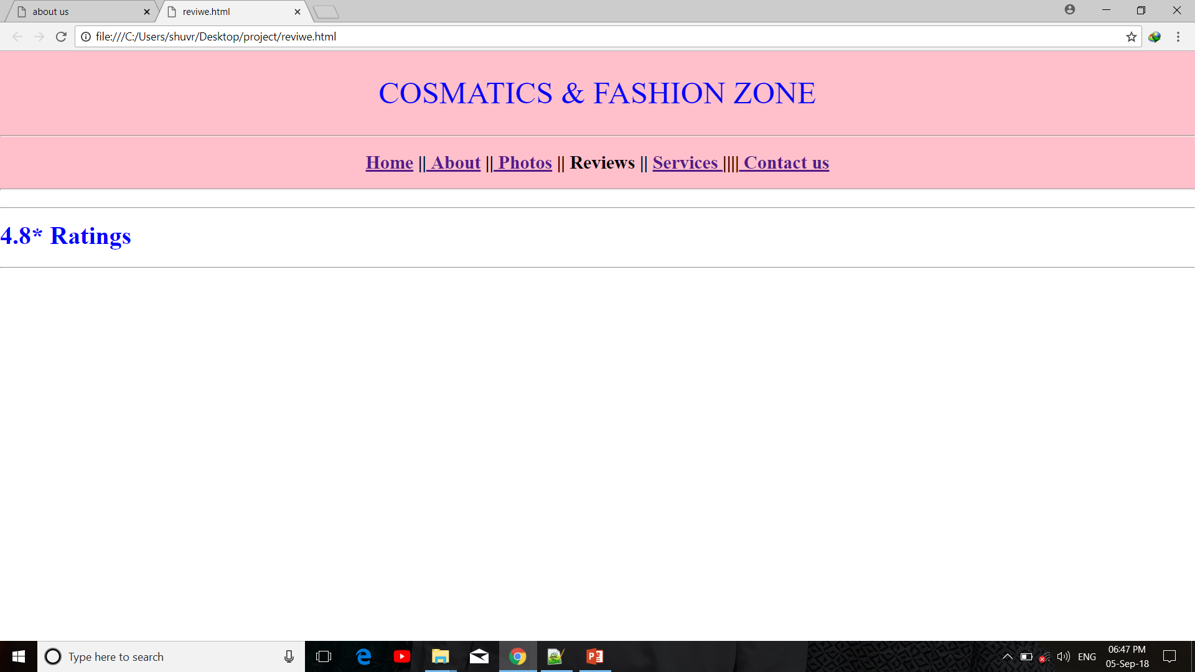
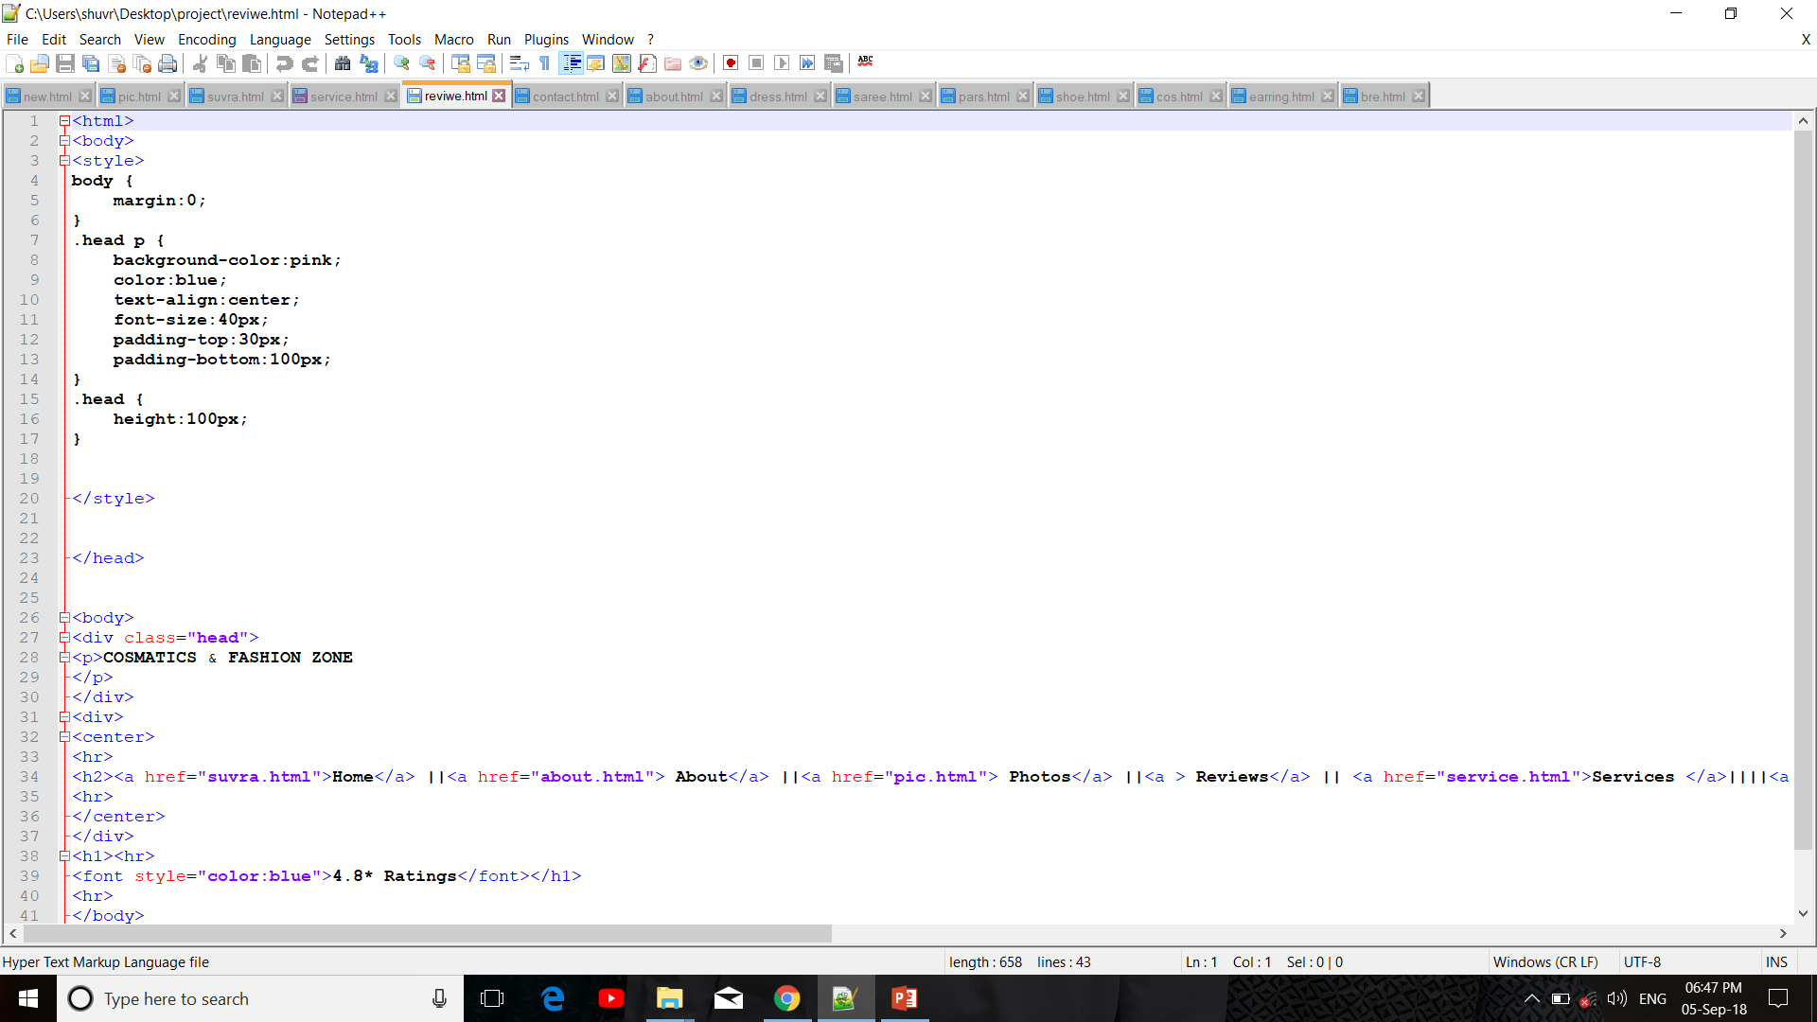
Here we use h2 tag, font color and hr tag to write ratings and highlight the ratings. And also use CSS for menu bar and heading.

Slide 16
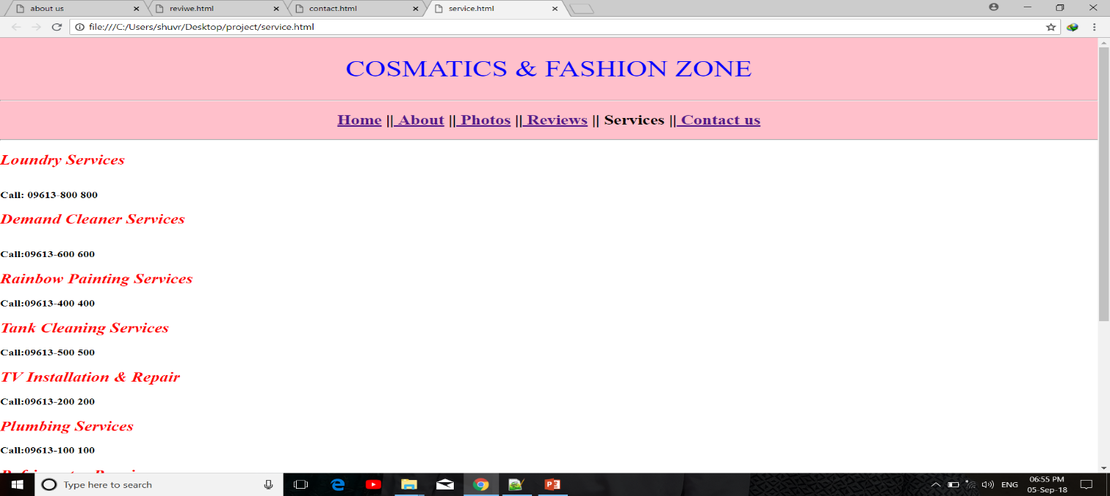
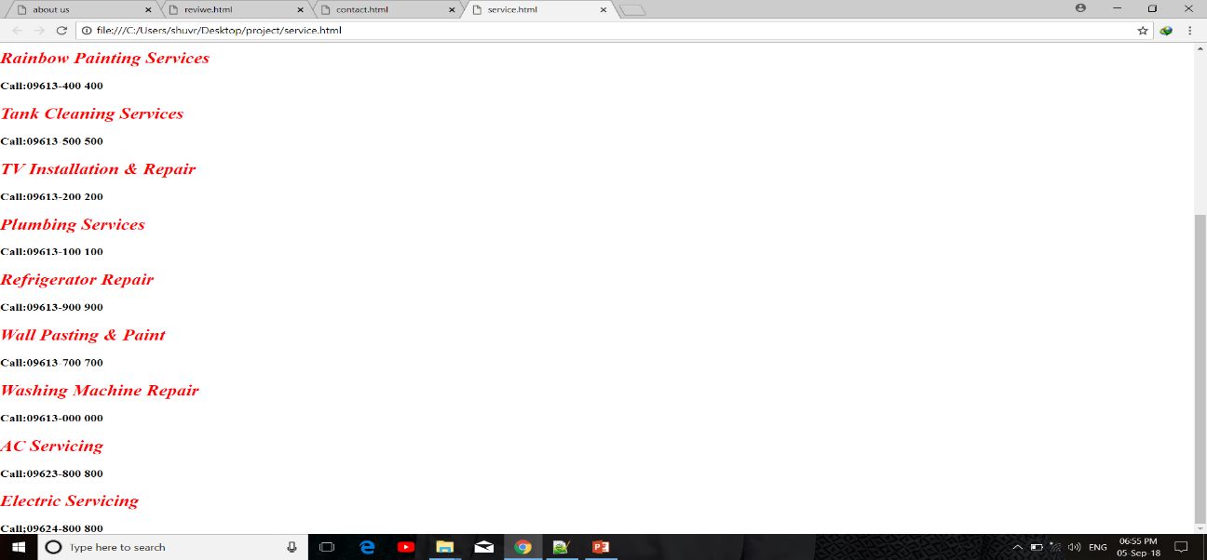
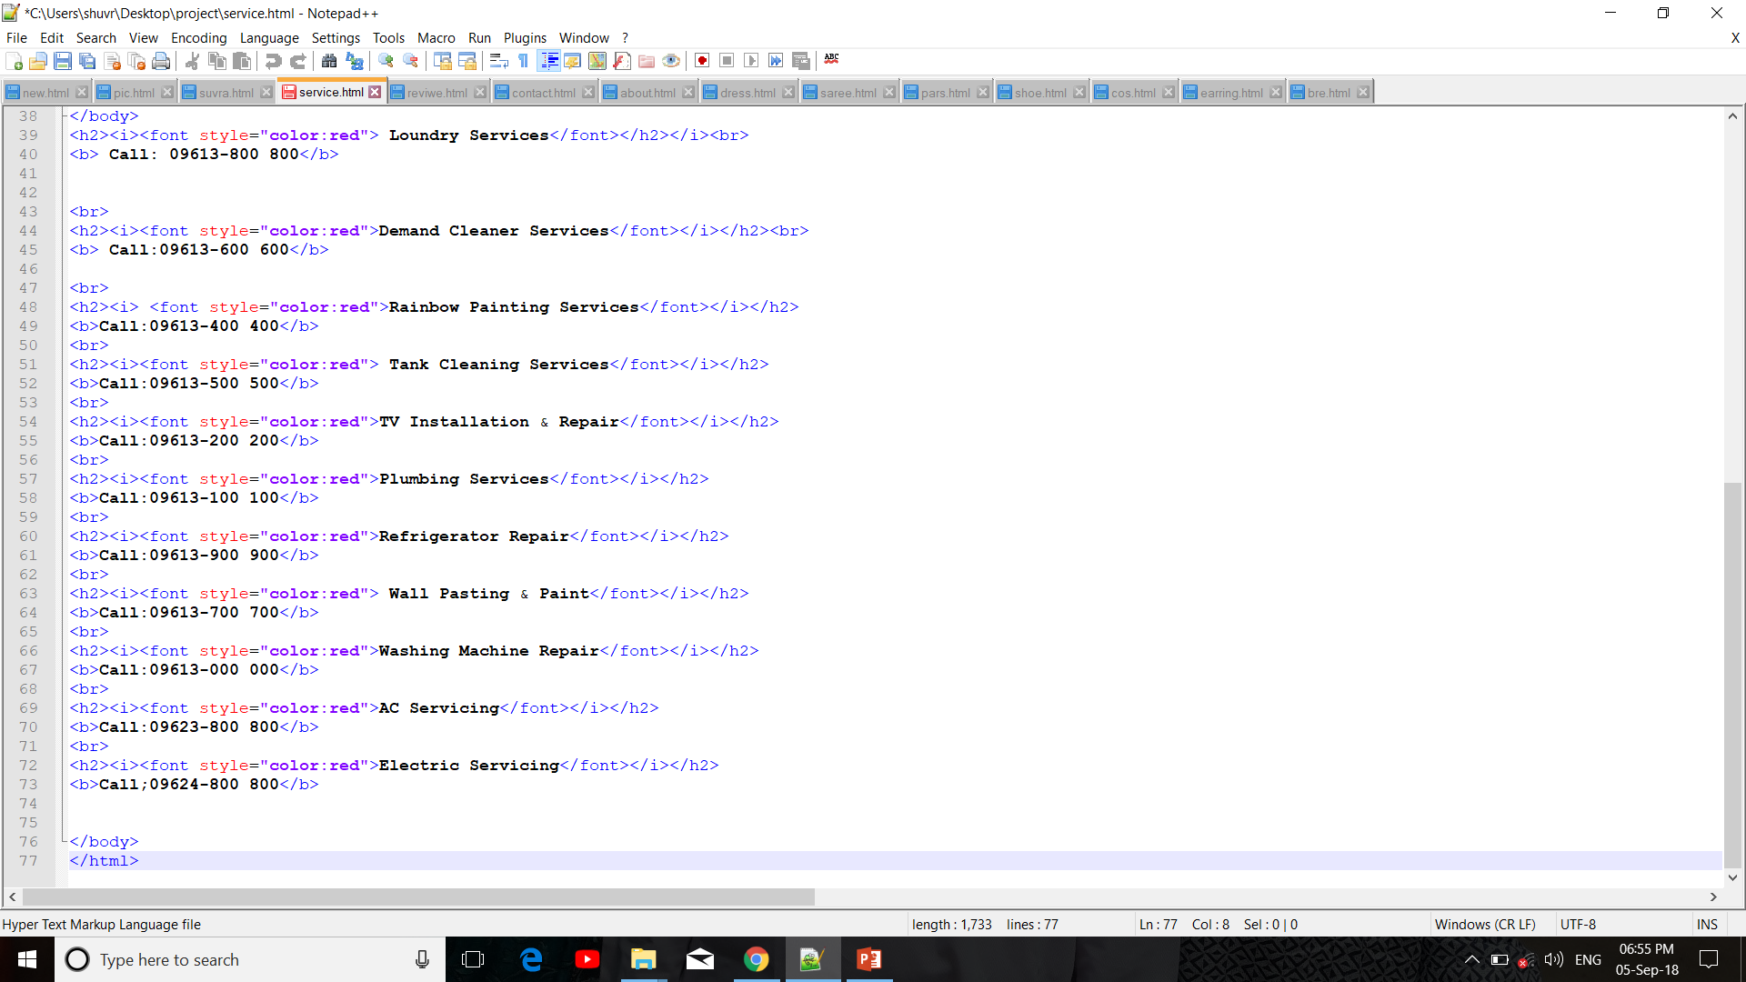
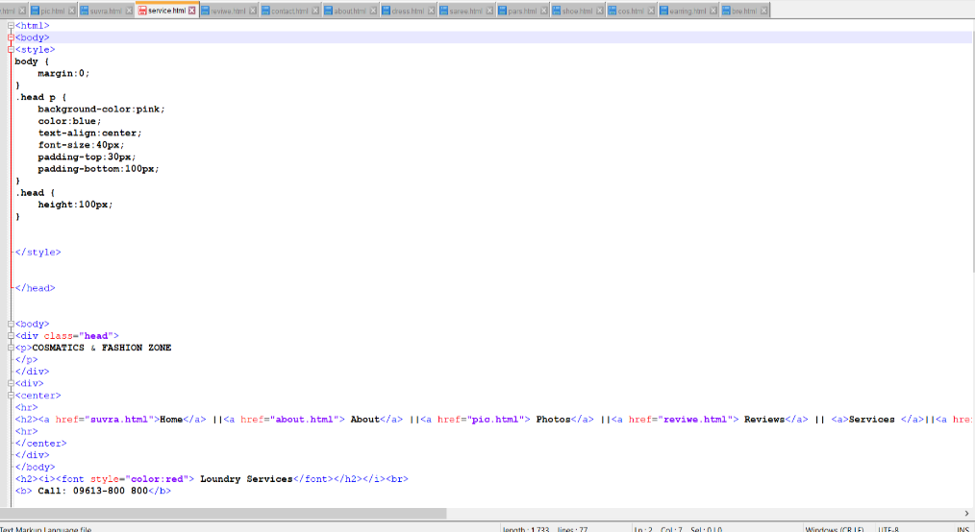
Here we use CSS for heading and menu bar. And font color tag, h2,h3 tag, Italic tag for creat our services page.

Slide 17
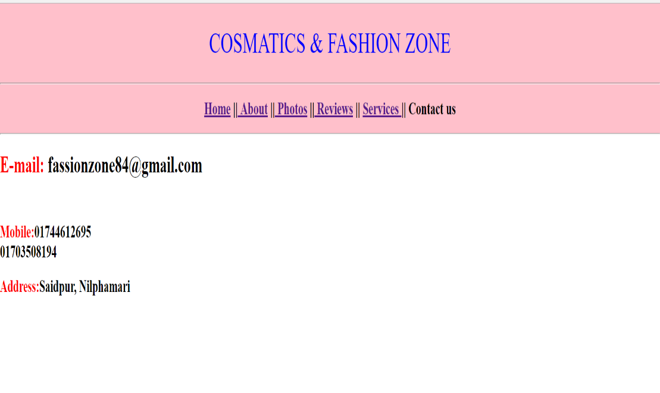
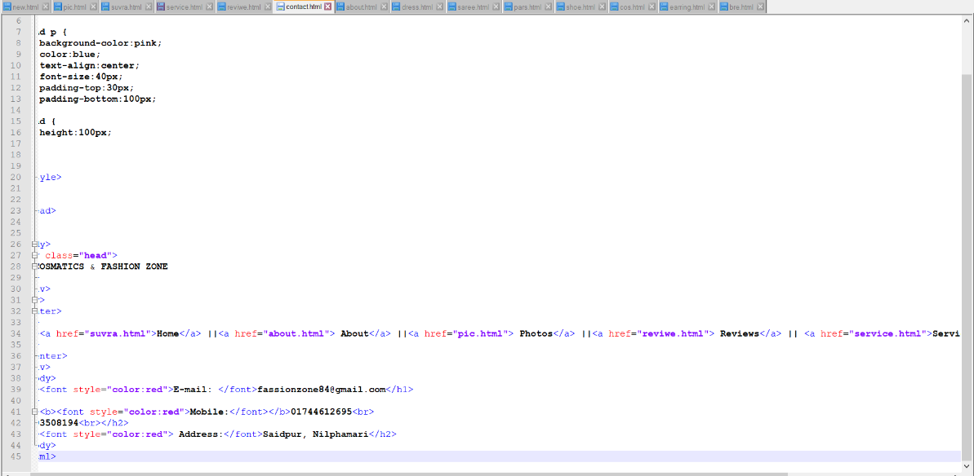
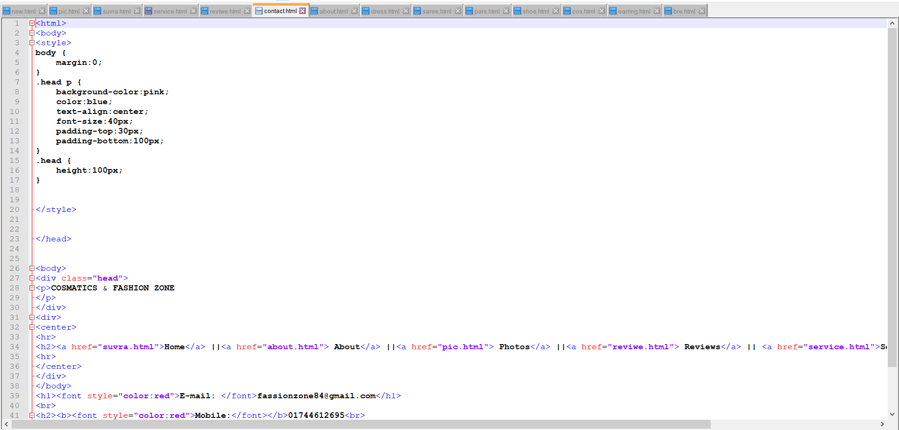
Here we use CSS for menu bar and heading. And also use font color tag, h2 tag for creat our Contact us page.

Slide 18
Thanks!

Slide 19


Munira Amin Shuvra
Mousumi Aktar Jharna
ID:180101014
ID: 180101032

